Slide 1
Presenter name:
Malcolm Henry
8/8/25
Kudos
Malcolm Henry
Product Operations Intern
Admin, Access & Insights

Slide 2
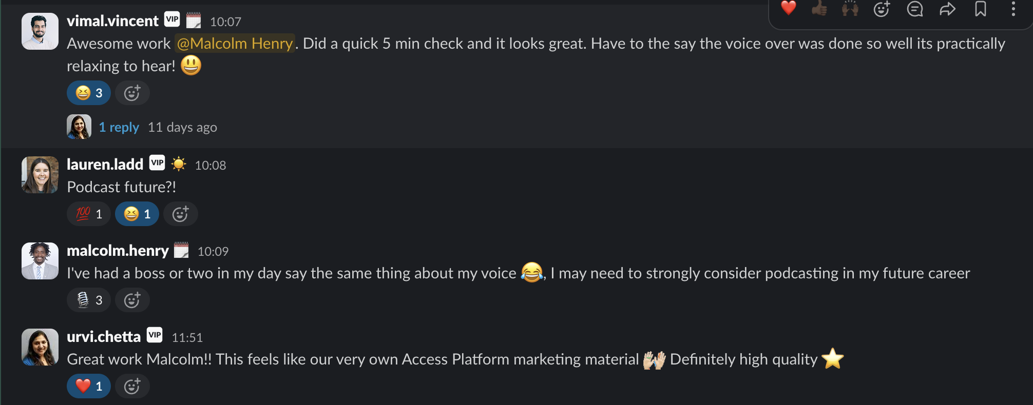
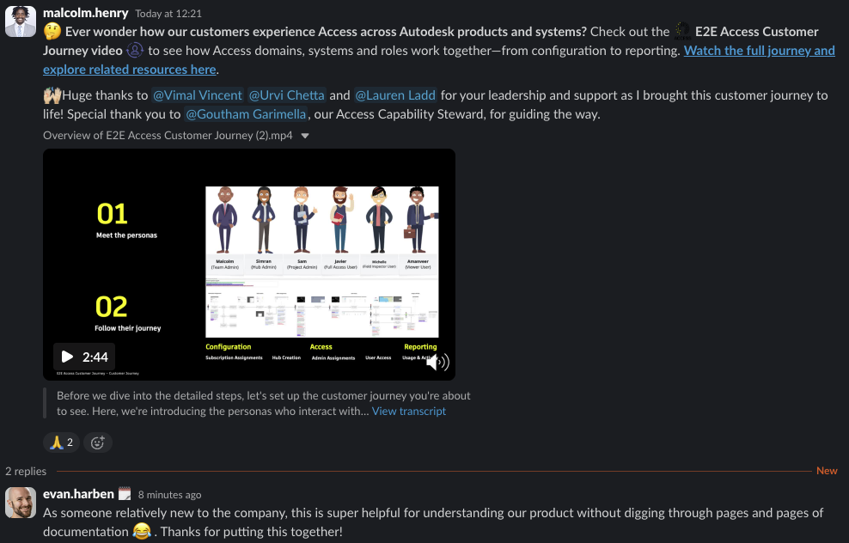


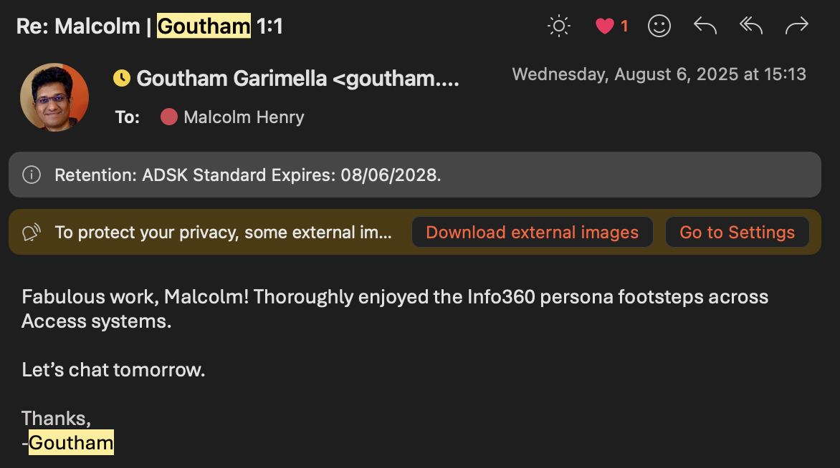

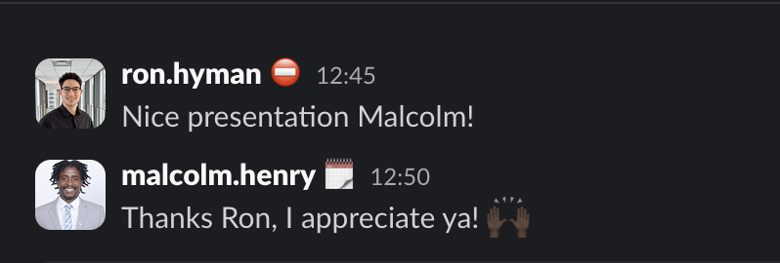

Slide 3
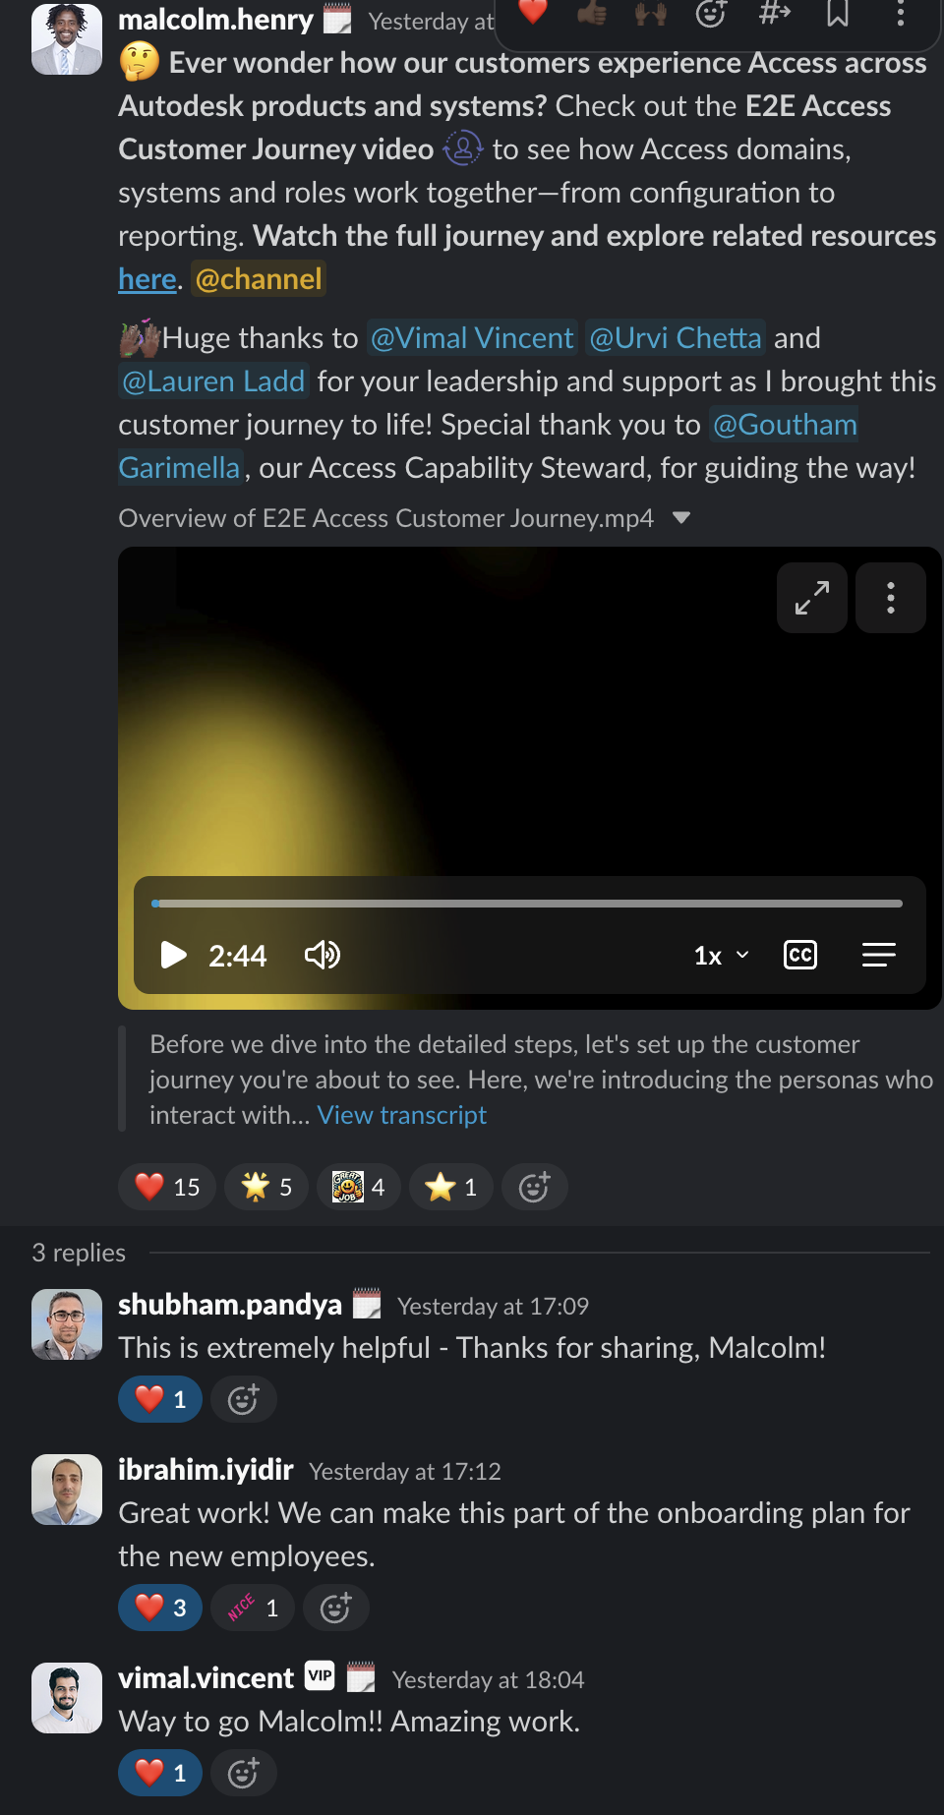

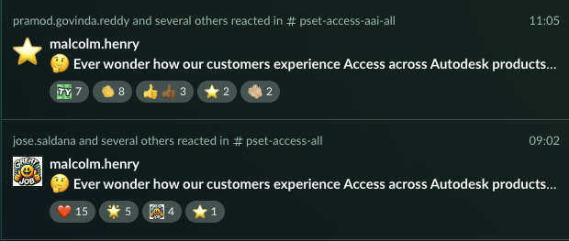


Slide 4
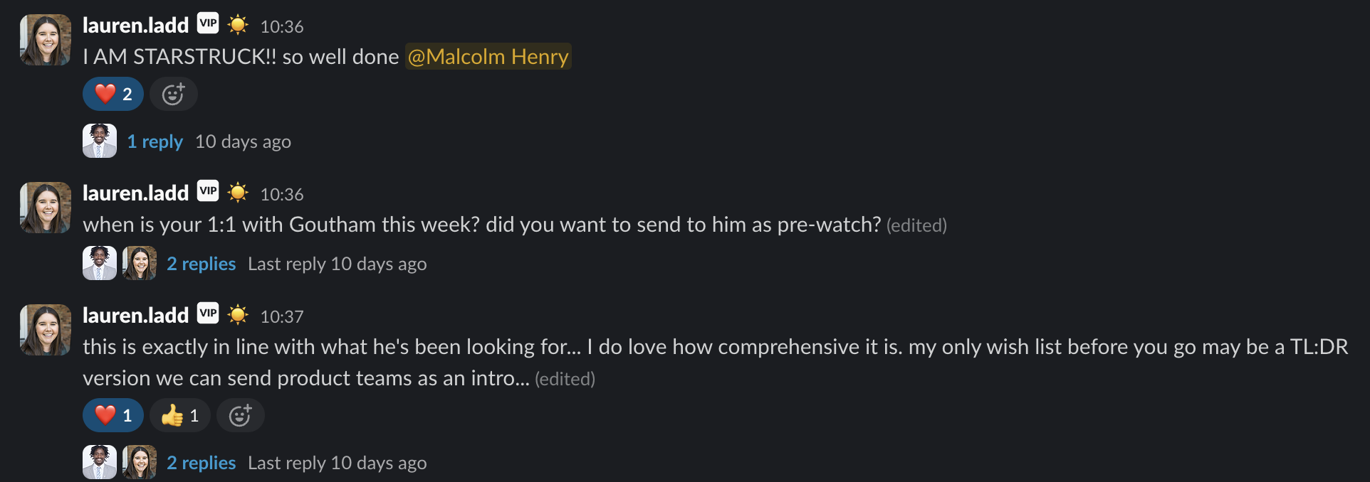

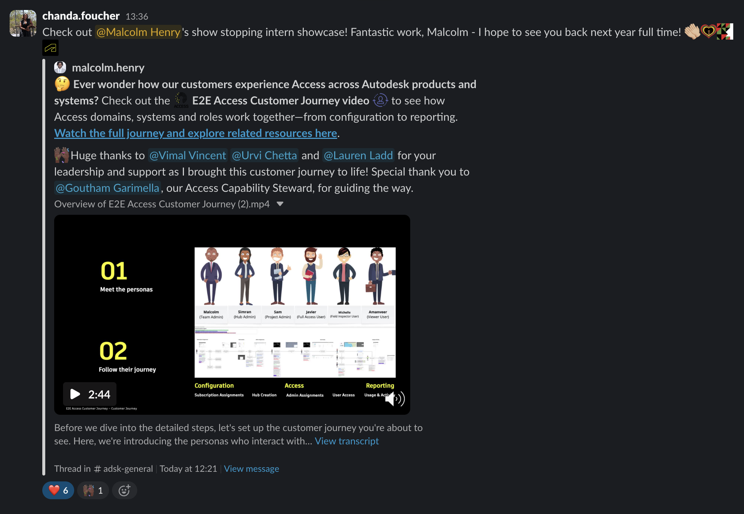

Slide 5
Thank you!
Malcolm Henry – Product Operations Intern | Admin, Access & Insights
Notes:
Thanks again for taking the time to listen. It’s been an incredible summer, and I’m grateful for the chance to contribute meaningfully to Autodesk.

