Slide 1

Forecasting Walmart Weekly Sales Across Different Stores
ISOM 655 Superforecasting
By:
Malcolm Henry

Slide 2

Index:
Problem & Motivation​
Dataset Overview​
Challenges Identified​
Proposed Solution​
Data Cleaning & Feature Engineering​
Modeling & Evaluation Metrics​
Key Findings​
Business Recommendations​
Conclusion & Future Work​

Slide 3

Problem and Motivation
Walmart, one of the world’s largest retailers, needs accurate sales forecasts for:​
Inventory optimization​
Cost reduction​
Enhanced customer satisfaction​
This project aims to create a model to predict weekly sales per store.​

Slide 4
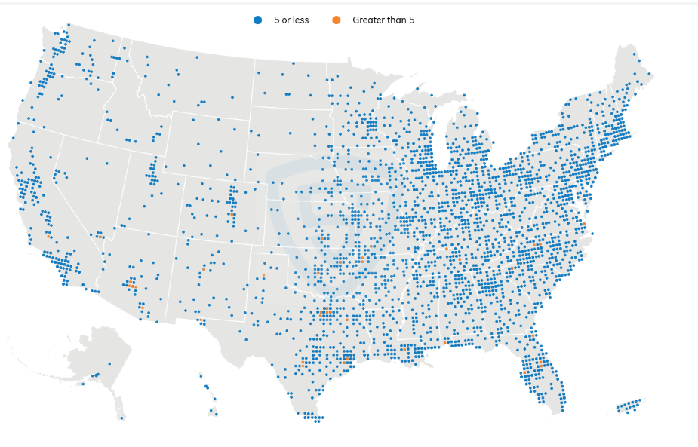
Dataset Overview
Data from 45 Walmart stores:​
Weekly Sales per Department​
Store characteristics​
Holiday indicators​
Economic data (CPI, Unemployment)​
Weather data (Temperature, Fuel Prices)​
Notes:
Shanika

Slide 5
Challenges Identified
1. Data Consistency Issues
Temporal Coverage:
  Weekly data collection over 3.5 years
  Sufficient for current predictions, but additional data could enhance model(s) accuracy
Data Gaps:
  Inconsistent markdown data across stores
  Missing CPI and unemployment data (May-July 2013)
  Limited weekly sales data (Feb 2010 - Oct 2012)
2. Seasonal and Holiday Patterns
Holiday Indicators:
  Data includes flags for major holidays:
  Valentine's Day
  Labor Day
  Thanksgiving
  Christmas
3. Economic Context
Significant Economic Shift:
  Unemployment rate declined from 9.8% (Feb 2010) to 5.9% (July 2013)
  Represents major macroeconomic change during study period
Notes:
Shanika

Slide 6

Proposed Solution
Data Cleaning & Feature Engineering​
Modeling with LSTM Deep Learning Model

Slide 7
LSTM as our chosen deep learning model, why?
Why LSTM for Walmart Sales Forecasting?
We selected a Long Short-Term Memory (LSTM) model which is a type of recurrent neural network (RNN) specifically designed to learn from sequential data and retain information over time, making them ideal for capturing temporal patterns, such as sales trends, seasonality, and promotional effects.
What the LSTM Model Offers:
Temporal Awareness: LSTM captures week-over-week patterns in sales that traditional models like linear regression or random forest ignore.
Handles Complex Interactions: Unlike SARIMA or linear models, LSTM can learn nonlinear relationships across multiple features, including promotions, fuel prices, store type, and department ID.
Embeddings for Categorical Context: Instead of treating store and department as dummy variables, LSTM learns dense representations (embeddings) that capture hidden patterns across locations and departments
LSTM Limitations:
Limitations for Unstable Stores: While strong overall, stores with erratic patterns or external disruptions still pose challenges, this is visible in higher MAPE scores and lower R2 scores for low-performing stores.
Limitations for long-term sequential data: Limited when dealing with a lot of data over a long period of time as the further out the model goes the harder it is to remember events and context from the beginning of the sequential data
Notes:
A Recurrent Neural Network (RNN) is a type of neural network that is designed to work with sequences of data — like time series, text, or audio.
Here's a simple explanation:
🔁 RNNs “remember” what they’ve seen before so they can make better predictions based on past information.
Imagine you’re watching a TV show — each new scene makes more sense because you remember what happened earlier. RNNs work the same way: they process one piece of data at a time and carry information forward to understand the next piece.

Slide 8

Data Processing, Engineering​, & Architecture
Data Merging & Cleaning
Merged datasets (train, features, stores) using Store and Date as keys with a left join for completeness.
Handled missing values by replacing all NAs with zeros to ensure model stability.
Standardized dates and filtered by time (Feb 2010 to Oct 2012) to enable a calendar-based train/test split (60/40).
Feature Engineering
Converted categorical columns (Store, Dept, IsHoliday, Type) into integer IDs to enable embedding layers
Normalized all numeric predictors and the target (Weekly_Sales) using z-score scaling for stable training.
Created a lag window of 6 weeks, capturing short-term temporal trends in past sales and conditions.
Model Architecture
Combined a stacked LSTM network with store and department embedding layers, enabling the model to learn nuanced sales patterns across both time and store context to predict next weeks sales.
Batch Size (256): Balanced training speed and generalization, especially useful with a large dataset (over 420K+ records).
Adam Optimizer: Chosen for its ability to adapt learning rates and converge efficiently in noisy, high-dimensional spaces.
25 Epochs: Enough to reach a steady decline in loss without overfitting, as observed in my loss/MSE curves.
Notes:
Scaled weekly sales then converted it to a vector, scaled features and converted it to a data frame, then I combined them into a matrix. I then created a lag window of 6 weeks and reshaped the matrix into a 3D array to be shaped and rotated properly for LSTM then took a time-based split of 60/40. Everything before 10/1/2011 is the training set with the incorporated lag. I then defined inputs (store, dept, features(window of prev. sales & features)), used embeddings to turn store and dept ID’s into numbers the model can understand and learn from. Then fed this into the lstm model to learn patterns over a window of data (past 6 weeks) and combined everything together to pass through a final layer to predict next weeks sales based on all of the previous past sales and features by store and department.

Slide 9
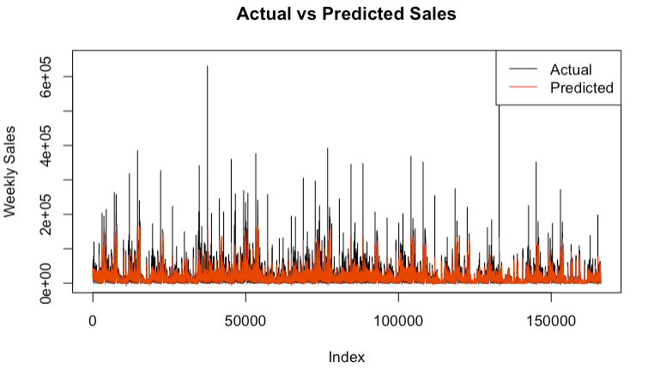
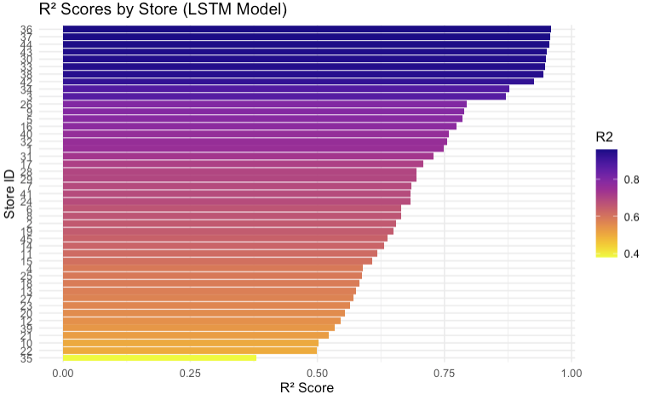
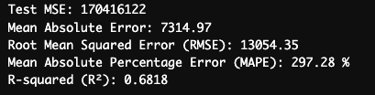
LSTM Deep Learning Model
Overall Model Fit: The LSTM model achieved an R² of 0.68 on the full dataset, indicating it explains about 68% of the variation in weekly sales across all stores and departments.
MAE (7,315) and RMSE (13,054) reflect strong average and outlier error performance, considering the large sales volume scale.
Strengths:
  Captures nonlinear and short-term weekly patterns across a diverse dataset.
  Performs well on high-volume stores with consistent historical data.
Limitations:
  Model performance still varies by store and department — best on stable or high-volume locations.
  High MAPE suggests the need for additional normalization strategies or log transformations to reduce impact of low-sales weeks.
Notes:
"Although the Test MSE is large in absolute terms, that’s expected given the scale of Walmart’s weekly sales across stores. A more intuitive metric like MAE ($7,314) shows the average prediction error is relatively modest. MSE is useful for penalizing large spikes, but it’s not always the best standalone measure for real-world performance in high-dollar forecasting.” MAPE of 297% is skewed by small actual sales values (e.g., zero or near-zero), where percentage error becomes inflated — a common issue in retail forecasting. May benefit from custom store/dept-level fine-tuning, embeddings, or including external drivers (e.g., events, markdowns).

Slide 10
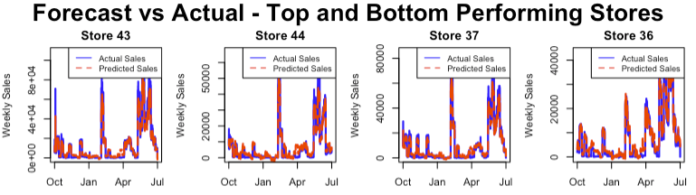
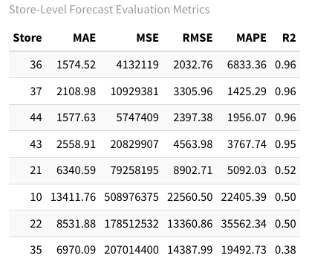
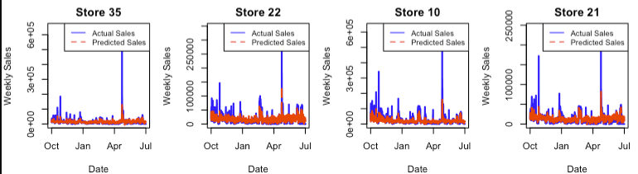
LSTM Deep Learning Model
LSTM (Long-Short-Term Memory) forecasts aligned closely with actuals for top-performing stores (e.g., Stores 36, 37, 44), achieving R² > 0.95 with low MAE and RMSE.
The model handles high-dimensional, multivariate time series data effectively by combining temporal sequences with contextual store information.
In contrast, stores like 10, 22, 21, and 35 show lower R² values (< 0.52), suggesting the model struggles with sales irregularities, possibly due to promotions, external events, or data sparsity in specific departments.
These MAPE values indicate that for many stores—especially those with low or volatile sales—the model’s predictions were significantly off in percentage terms, often due to small actual sales values inflating the error.
Notes:
For top-performing stores like Store 36 and 44, the MAE is below $1,600, which is exceptionally low relative to their weekly sales volume — indicating highly accurate forecasts.
Because MAE is not inflated by outliers (unlike MSE/RMSE), it’s a strong metric for assessing consistent, everyday performance of the model.

Slide 11
Modeling and Evaluation Metrics
Models – LSTM | Evaluation Metrics | Train/Test Split & Cross-Validation
Used LSTM with embedding layers to capture temporal patterns, store identity, and department context in multivariate weekly sales forecasting. | MAE – Average magnitude of error | Train/Test Split & Cross-Validation: Calendar-based time split (pre/post Oct 1, 2011), approximating an 60/40 division depending on data distribution.
Captures both short-term trends and complex nonlinear interactions between features (e.g., store/department embeddings, fuel prices, promotions). | RMSE – Penalizes larger errors more | Out-of-sample forecasting
Allows for learning of latent representations of categorical inputs, improving generalization for each store and department. | R² – Relative variance explained | Static evaluation (can add rolling windows later)
Provides intuitive percentage-based error for interpreting forecast accuracy, especially useful for comparing performance across stores or departments with different sales volumes. | MAPE – Measures relative error as a percentage of actual sales; can be inflated when actual values are near zero. | Results most reliable for higher-volume stores; caution needed when interpreting error in departments with low or sparse sales.
Notes:
This slide summarizes our modeling framework and evaluation metrics.

Slide 12
Business Recommendations​
Leverage high-performing forecasts (e.g., Stores 36, 37, 44) to drive precision inventory planning in top-performing locations with strong seasonal trends and low forecast error.
Proactively manage underperforming stores (e.g., Stores 10, 21, 22, 35) by layering external factors (e.g., weather, local events) and manual overrides to improve accuracy in volatile locations.
Use weekly forecast outputs to inform staffing and logistics, especially around promotional periods and major holidays, enabling lean operations and reduced waste.
Integrate predicted dips or spikes into marketing calendars, targeting low-volume weeks with localized campaigns or price adjustments.
Continuously retrain the model with fresh data to capture evolving trends post-2012 and deploy in rolling production windows for real-time forecasting across all stores and departments.

Slide 13
Key Findings​
Seasonality and holidays are major sales drivers across most Walmart stores.
LSTM was especially useful for generalizing across stores and departments, leading to strong R² (>0.95) for top-performing locations.
Notes:
"Let me walk you through some key findings from our model performance comparison.
First, seasonality and holidays emerged as major drivers of weekly sales across most Walmart stores. To address this, we tested different models on their ability to handle trends, seasonality, and store-specific patterns.
The SARIMA models worked well for stores with strong, consistent seasonal patterns. However, they were less adaptive to sudden external shocks or promotional events.
Our LSTM model showed standout performance—especially on high-volume, non-linear stores.
Random Forest also performed competitively, especially on RMSE and MAE metrics. But since it's not inherently time-aware, it couldn't fully leverage the sequential nature of the data.
Lastly, Linear Regression significantly underperformed. It failed to capture nonlinearity and sequential dependencies, consistently underfitting across all store types.

Slide 14
Conclusion & Future Work​
Conclusion:
Our LSTM model effectively forecasted weekly sales across Walmart stores, especially for locations with steady historical patterns and high sales volume.
Embedding layers and lag-based features enabled the model to capture store-specific trends and short-term dynamics that traditional models missed.
Performance on volatile or low-volume stores remains limited, suggesting a need for additional contextual features or external event data.
Future Work:
Incorporate external data: weather, local events, promotional calendars to improve volatile store forecasts.
Scale to product-level or SKU-level forecasting, increasing operational impact.
Deploy rolling forecasts in production, updating weekly with fresh sales data for real-time business use.

