Slide 1



Telco Churn Analysis
Caroline Dong & Malcolm Henry

Slide 2

Agenda
Overview
Inference
Retention Strategy
Predictive Analytics
Conclusions & Next Steps

Slide 3


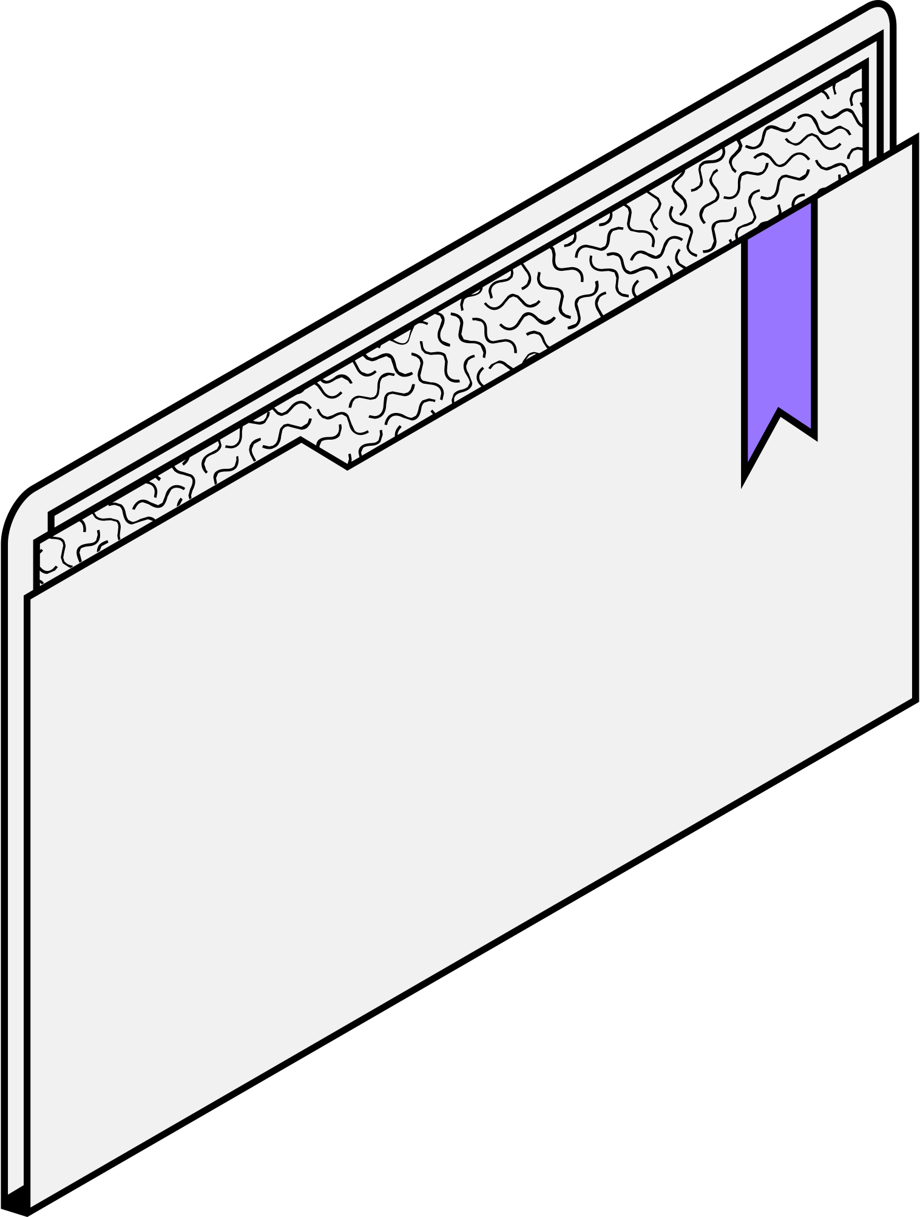

Overview
Objective: Analyze customer churn for a telecommunications company.
Inference: Identify key churn drivers and suggest retention strategies.
Prediction: Build a churn prediction model with high accuracy.

Slide 4
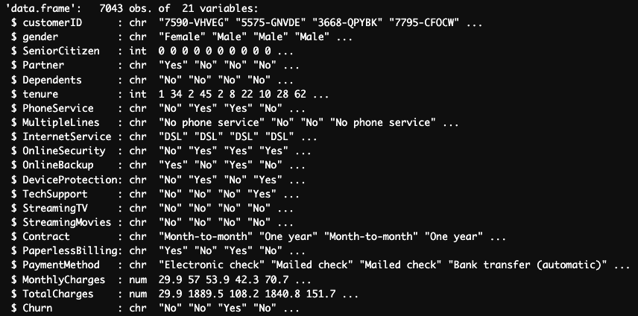
Overview: Customer Data Input Variables
Data Structure:
Demographics
Years as a customer
Services
Account info
Y variable

Slide 5
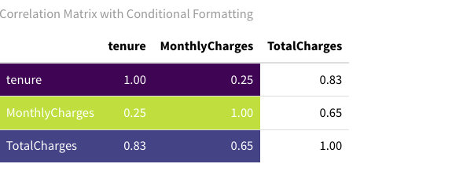
Overview: Nested Variables & Collinearity
Nested Variables:
Nested in PhoneService
Nested in InternetService
Notes:
Data transformed to 0 and 1

Slide 6
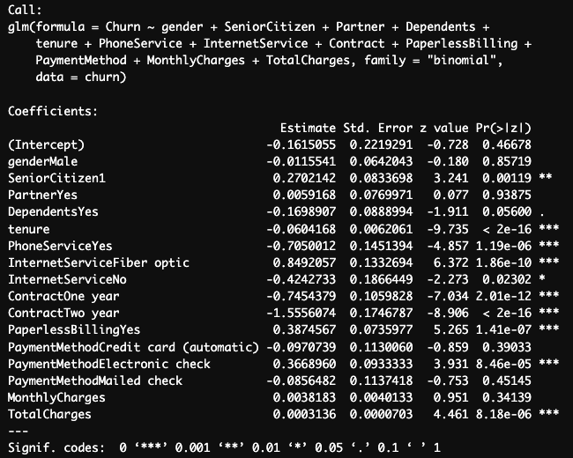
Inference
Significant Variables
SeniorCitizen
Tenure
PhoneService
InternetService
Dependents*
Contract
PaperlessBilling
TotalCharges

Slide 7

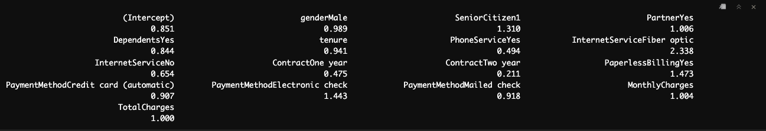
Inference
Services
Customers with fiber optics internet service are 134% more likely to churn than customers with DSL internet service.
Account
Customers with a one-year contract are 53% less likely to churn than those with month-to-month contracts while customers with a two-year contract are 79% less likely to churn than those with month-to-month contracts.
Customers who pay by electronic check are 44% more likely to churn than those that pay by those that pay by automatic bank transfer.
Customers that choose paperless billing are 47% more likely to churn than those that do not use paperless billing method.

Slide 8



Retention Strategy
Demographics
Services
Accounts
Since senior citizens are 31% more likely to churn than non-senior citizens, we should target our marketing efforts towards a younger demographic. Especially young adults, as we can potentially turn them into lifetime customers.
Having Fiber optic internet service increases the likelihood of customers leaving by 134% in comparison to DSL. This indicates poor performance and customer satisfaction, meaning we should explore the root cause and either improve, replace, or cancel fiber optic.
Longer-term contracts, specifically two-year contracts decrease the odds of customers leaving by 79% in comparison to month-to-month contracts. We should focus on converting month-to-month customers to two-year contracts and also offer longer-term contracts to increase CLTV and profits.

Slide 9
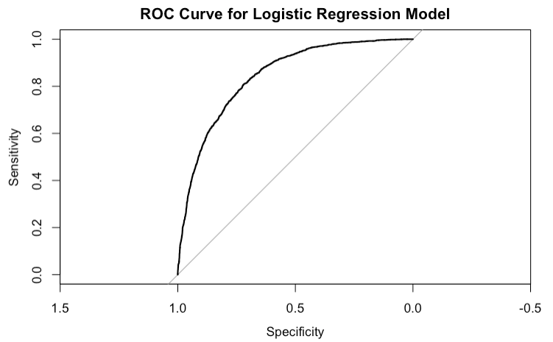
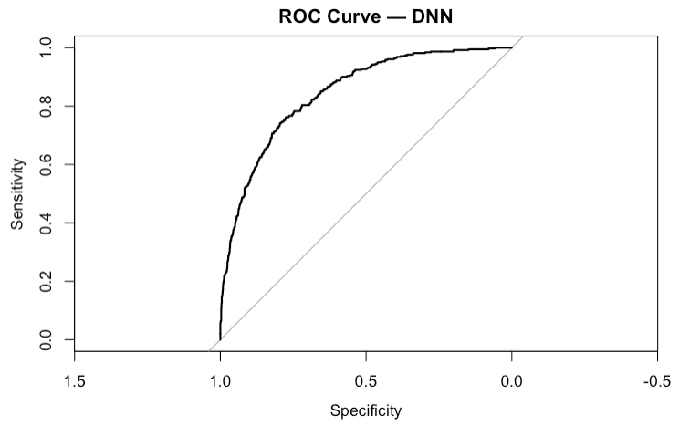



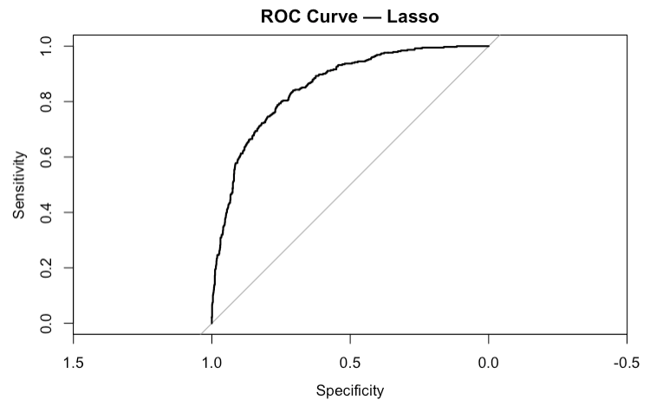
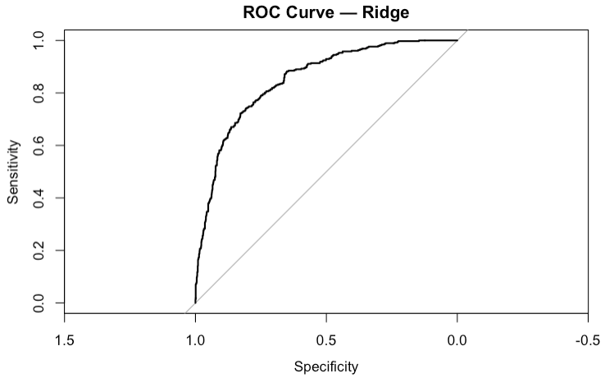


Predictive Analytics

Slide 10


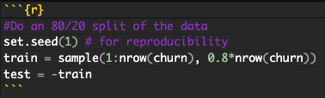
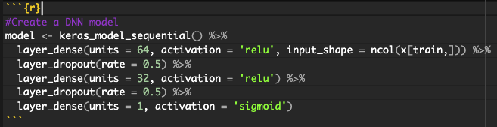
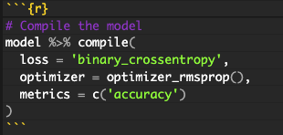
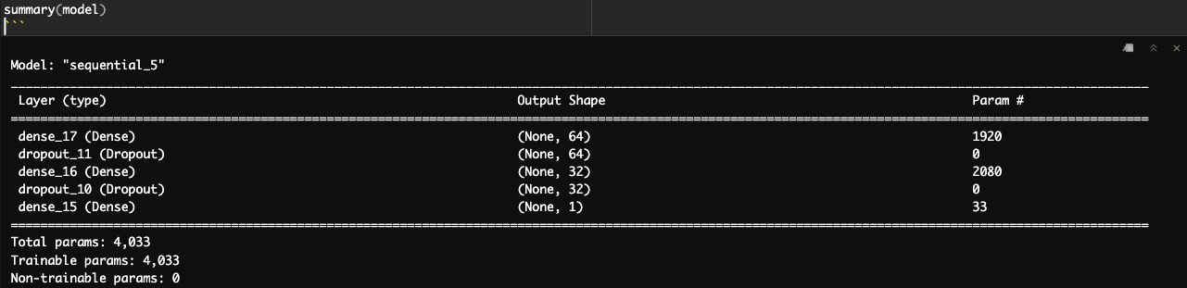


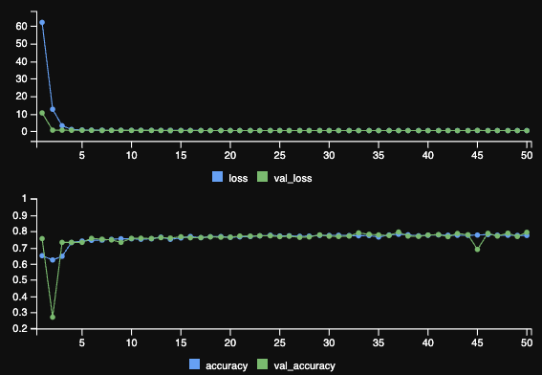
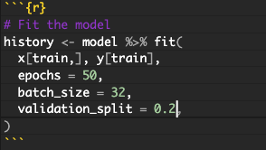
DNN Architecture

Slide 11
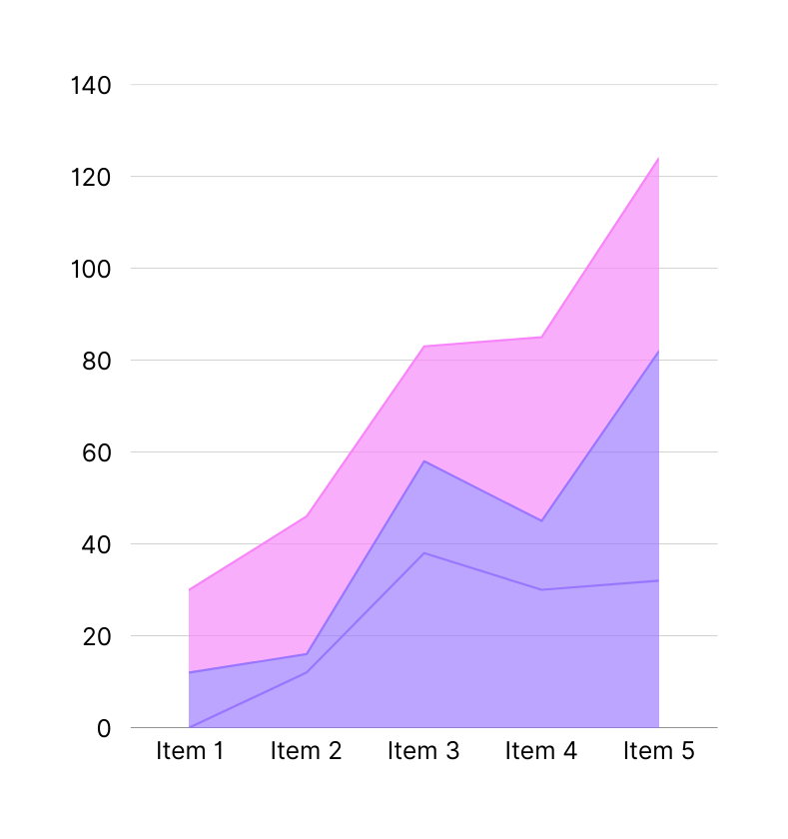
Limitations of
Our Models
Logistic Regression: assumes a straight-line (linear) relationship in log-odds, can miss nonlinear patterns
Add interaction terms (e.g. tenure*Contract) to capture joint effects
& how to improve
Ridge & Lasso: still linear models & only shrink or drop coefficients, do not capture curves or splits
Feature engineer: turn key predictors into categories or bins (e.g. tenure buckets) so shrinkage acts on more meaningful blocks
Deep Neural Net: can over-fit small tabular datasets & memorizes noise rather than general patterns
Reduce complexity: try just one hidden layer with fewer units (e.g. 16 batch size)

Slide 12

Recommendations for Management
Target senior citizen customers by promoting paper billing and discounts on contracts
Prioritize premium services like DSL to existing customers while exploring the root cause of poor Fiber optic internet service and either improving, replacing, or canceling the fiber optic product as a whole
Incentivize longer-term contracts
  Month-to-month customers: discount 1 and 2-year contracts for limited times to convert these customers to consistent paying customers
  Customers with 1 and 2-year contracts: advertise and offer discounted rates for early renewal
  Offer longer-term contracts with discounts, potentially 3-5 years, to increase customer lifetime value and ultimately profits

Slide 13
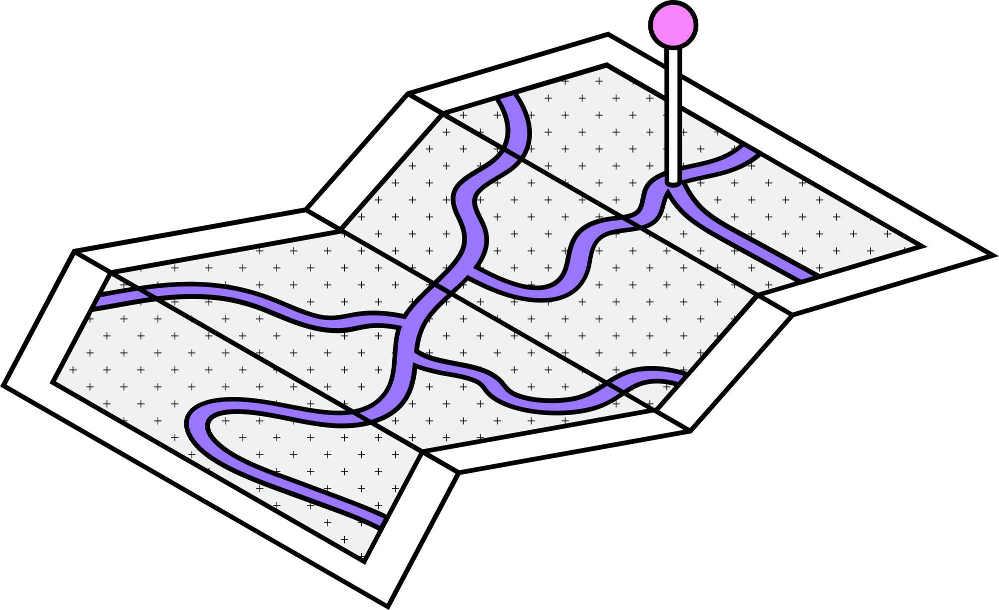

Next Steps
Test and validate targeted retention strategy using A/B testing to determine success for offering discounts, promoting paper billing and defaulting to paper billing for senior citizens
Conduct a root-cause analysis on pain points the user is experiencing in regard to the fiber optic internet service. This could be done by taking customer support and feedback data from the end-user
Determine consumer appetite for longer-term contracts by collecting key data and predicting customers willingness to pay across various long-term contract offerings. This could be done by conducting a conjoint analysis of end-users in our target market.
Notes:
Monitor churn trends and update model periodically
Relate it back to CLTV

